Slide 1

IBM Project Presentation
on
“Proactive Equipment Care using Analytics with Cloud - Cloud Integrated Analytics”
By
Group ID: G03
Team Members Name & Enrollment No:
Patel Megh(22162121011)
Prajapati Pratham(22162171023)
Patel Tirth(22162101016)
Under The guidance of
Prof. Umesh Lakhtariya /Mr. Anoj Dixit
Institute Of Computer Technology, Ganpat University
Date:- 06th May 2026

Slide 2
Index Of Content
Abstract
Problem Statement
Objectives
Scope of the Project
Workflow of Project
ML Training Workflow
System Architecture
Technology Stack
Module Description
Advantages
Limitations

Slide 3
Abstract
Proactive Equipment Care using Analytics with Cloud is a cloud-based intelligent maintenance system designed to predict equipment failures before they occur.
Traditional maintenance approaches are reactive, leading to unexpected downtime and high repair costs. This system integrates data analytics, machine learning, and cloud computing to monitor equipment health in real-time.
Motor data is processed and analyzed to detect patterns and anomalies.
The ML model predicts potential failures, enabling preventive maintenance.
The solution improves operational efficiency, reduces downtime, and enhances equipment lifespan.

Slide 4
Problem Statement
Industries rely heavily on reactive maintenance strategies, where equipment is repaired only after failure occurs. This leads to:
Unexpected equipment failures lead to production loss, increased downtime, high maintenance costs, and potential safety risks in industrial environments.
Traditional reactive maintenance approaches address issues only after failure, resulting in inefficient operations, higher repair costs, and poor maintenance planning.
There is a need for a cloud-based smart system with analytics to enable continuous monitoring, centralized data storage, and data-driven decision-making for optimized maintenance and resource management.
Solution:- There is a need for an intelligent cloud-based system that can predict equipment failures before they happen.

Slide 5
Objectives
To develop a cloud-based predictive maintenance system for continuous remote monitoring, secure data storage, and intelligent analysis of equipment performance.
To collect and process key motor data (temperature, vibration, load) and apply machine learning algorithms to accurately assess equipment health and predict potential failures.
To provide a real-time dashboard that visualizes equipment status, predictions, and historical trends for effective monitoring and decision-making.
To reduce downtime and maintenance costs by enabling proactive maintenance through advanced analytics and early fault detection.

Slide 6
Scope
Our idea will Help in:
To continuously monitor equipment condition in real time by tracking parameters such as temperature, vibration, and load for accurate performance assessment.
To predict potential equipment failures using data-driven and machine learning models that identify patterns and early warning signs.
To enable remote monitoring and real-time accessibility through cloud integration, ensuring scalability and efficient handling of large data and multiple devices.
To support applications in industries like manufacturing, power plants, and heavy machinery, with IoT integration for smart sensors to improve maintenance efficiency and reduce operational risks.

Slide 7
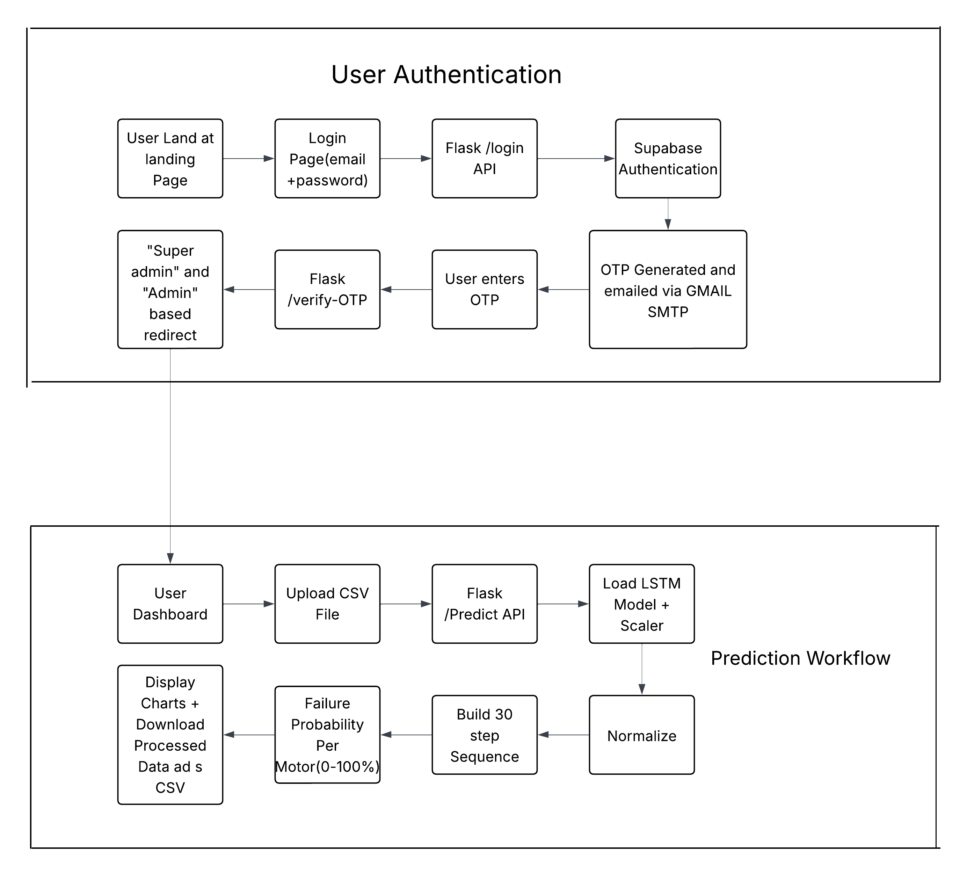
Workflow Of Project

Slide 8
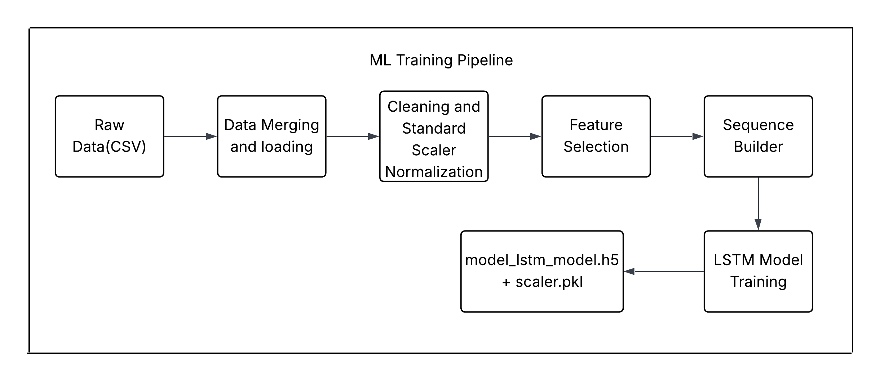
ML Training Workflow

Slide 9
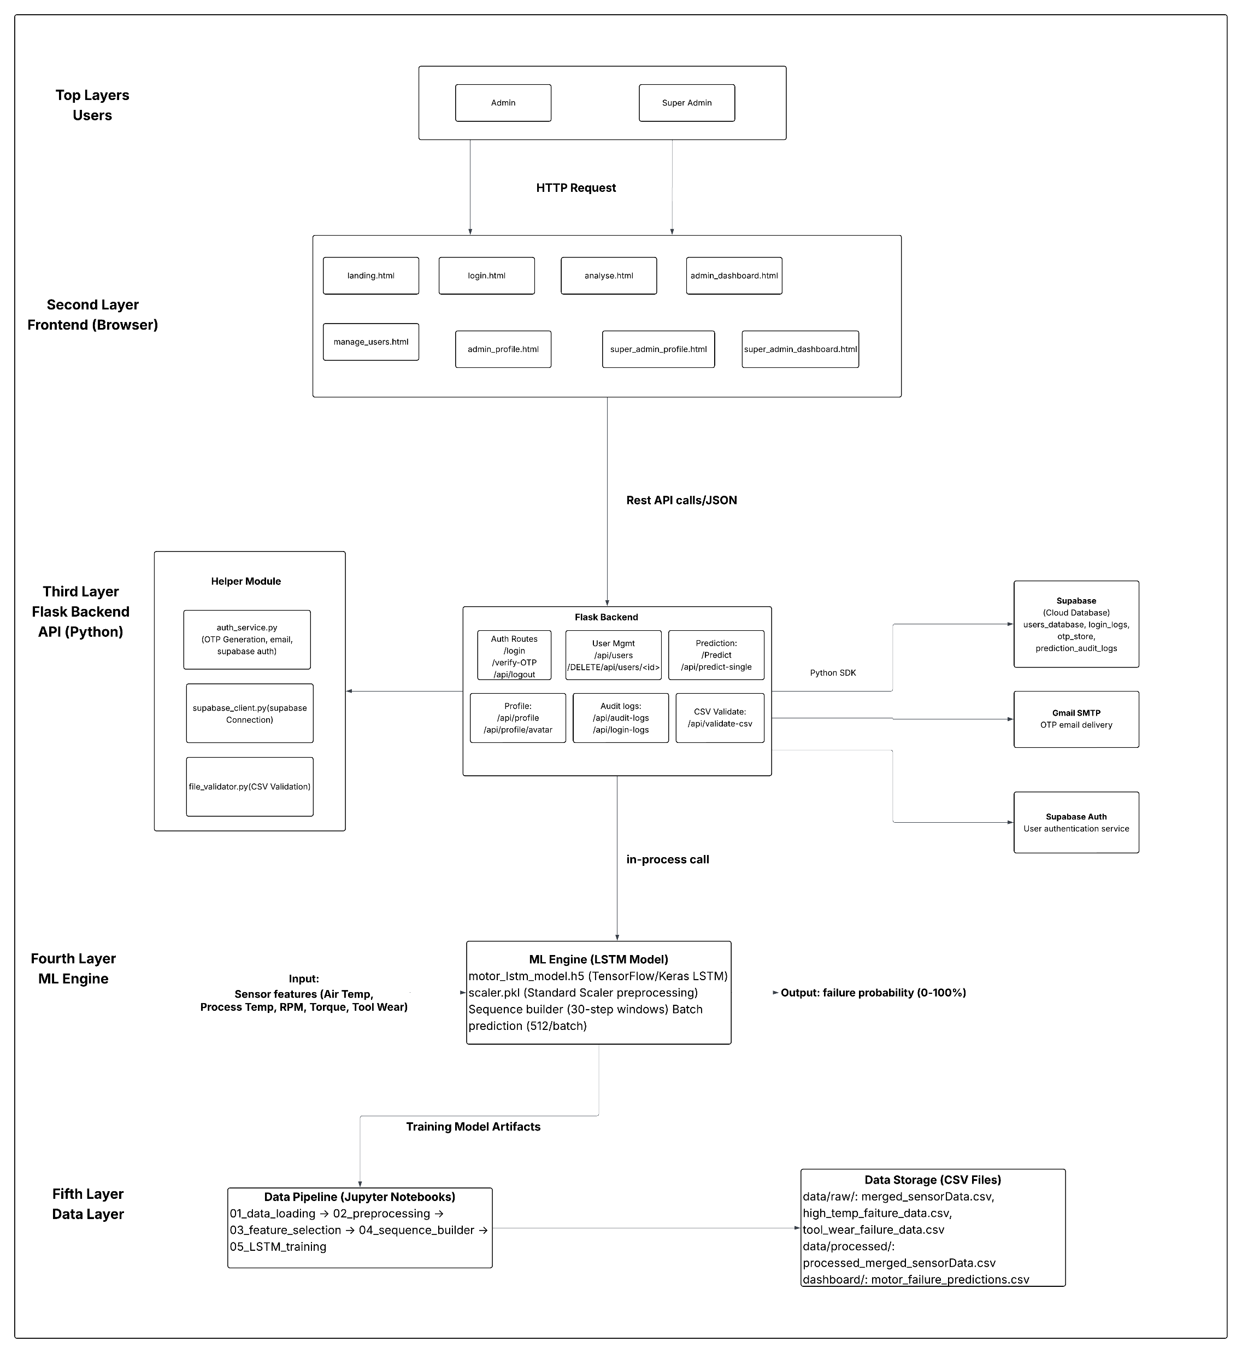
System Architecture

Slide 10
Module Description
Data Generation Module
Collects and manages motor sensor data such as temperature, vibration, current, and load, either from cloud storage or simulated CSV datasets.
Data Processing Module
Cleans, normalizes, and prepares raw sensor data through preprocessing and feature engineering for accurate model training.
Prediction Module
Uses the trained LSTM machine learning model to analyze time-series data and predict equipment failure probability.
Dashboard Module
Displays real-time equipment status, prediction results, and historical trends through an interactive web-based interface.
Authentication Module
Handles secure user login, role-based access control, and logging of user activities using cloud-based authentication services.

Slide 11
Confusion Matrix
 | Safe | Fail
Actual Safe | 2248 | 1499
Fail | 99 | 148
This gives us:
Accuracy: 59.9% (overall correct predictions)
Sensitivity: 59.9% (we catch ~60% of actual failures)
Specificity: 60% (we correctly identify ~60% of safe motors)
Precision: 9.0% (when we predict 'fail', correct only 9% of time)
NPV: 95.8% (when we predict 'safe', correct 95.8% of time)

Slide 12
Advantages
Reduces unexpected breakdowns and maintenance costs by predicting failures in advance and shifting from reactive to planned, condition-based maintenance.
Increases equipment lifespan and operational efficiency through continuous monitoring and early detection of performance degradation.
Provides real-time monitoring of equipment health parameters, enabling faster decision-making and better operational control.
Ensures cloud scalability and secure data storage with controlled access, allowing efficient handling of large data volumes and protection of sensitive information.

Slide 13
Limitations
Requires high-quality and sufficient historical data to train machine learning models effectively, as poor or imbalanced data can reduce prediction accuracy.
Involves high initial setup costs due to cloud infrastructure configuration, system development, and model training.
Depends on stable internet connectivity for continuous cloud access, real-time monitoring, and data synchronization.
Needs periodic model retraining to adapt to changing equipment behavior, new failure patterns, and updated operational conditions.

Slide 14
Conclusions
The Proactive Equipment Care system provides a scalable predictive maintenance solution by integrating cloud computing, data analytics, and deep learning to continuously monitor and analyze equipment data.
The use of an LSTM-based model improves prediction accuracy and enables early failure detection, allowing industries to receive alerts 24–48 hours in advance for proactive maintenance.
The system transforms traditional reactive maintenance into a data-driven approach, reducing downtime and costs while improving equipment reliability, productivity, and overall operational efficiency.

Slide 15
Thank You

